Slide 1
Hospital Management System
Team members:
EBEON1222725218-Santhiya S
EBEON1222724679-Subathra S
EBEON1222708618-Surya J
EBEON1222722743-Sulochana Y
EBEON1222710200-Kalaimahal E
Guided by:
Varadharajan A

Slide 2
Hospital Management System-Module
Home Page module
Admin module
User module(patient)
Doctor module
Appointment Scheduling module
GPS Tracking module
Department module
Chat boot module

Slide 3
Abstract
The Hospital Management System is a comprehensive software solution designed to streamline the administrative and clinical workflows of healthcare facilities.
This system includes various modules such as patient management, appointment scheduling, pharmacy inventary, and more, all of which work together to improve the overall efficiency and quality of care provided by hospitals.

Slide 4
Goals of Modules
User friendly
Simple fast
Low cost and effective
It deals with the collection of patient’s information
List of modules:
Homepage
Admin page

Slide 5
Homepage
Services
Key features of our hospital
Our doctor team

Slide 6
Admin module
Register –Sign in (log in)
manage departments of hospital user, doctor accounts.
watch appointment of users(patients)
watch medicine status of hospital stock
Admin has right to change the information of doctors like name, qualification and password.

Slide 7
Challenging Issues
Database connectivity issue
Server issue
Module interconnection issue
Coding issue

Slide 8
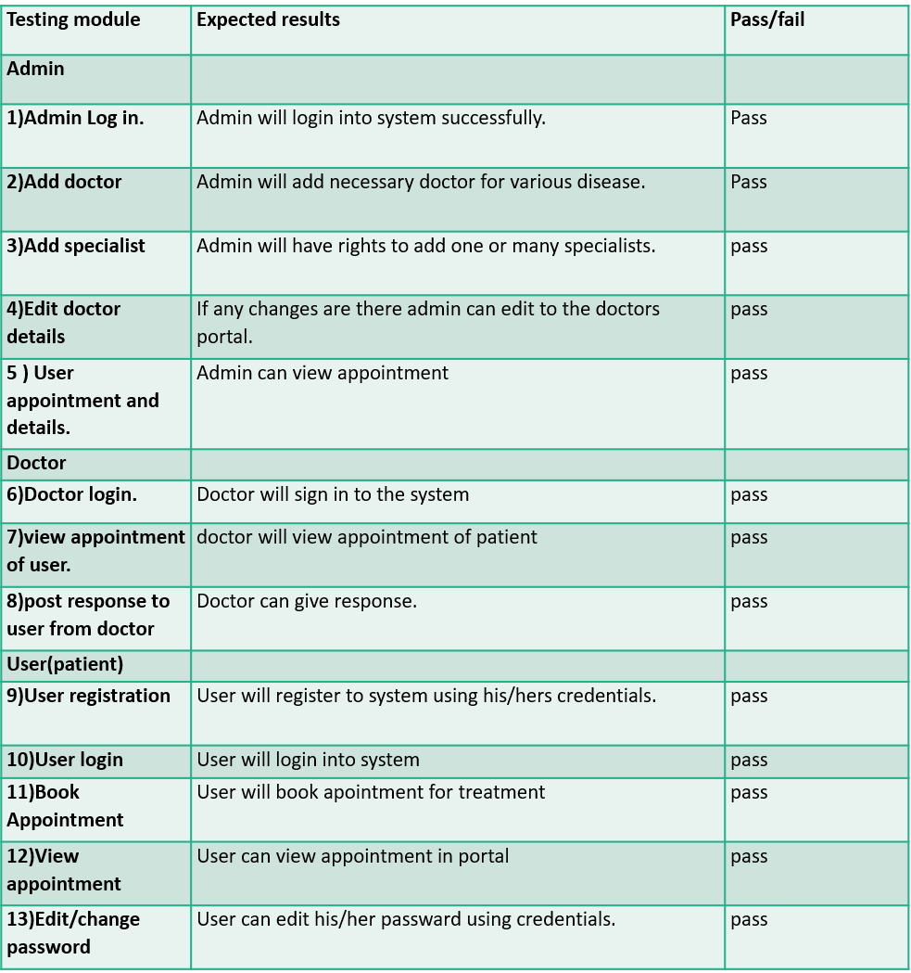
Testing

Slide 9
Future enhancement
Room booking section.
Virtual meeting with doctors

Slide 10
conclusion
In conclusion, the Hospital Management System is a powerful tool that can help healthcare providers improve the quality of care they provide while streamlining their administrative and clinical workflows.
With its various modules and features, this system can simplify the management of patient data, appointment scheduling, billing, inventory, and more, enabling hospitals to focus on what matters most - providing excellent healthcare services to their patients.

Slide 11
Thank you

